Slide 1

DATA CENTRES: BEHIND THE HEADLINES
An Induction Data Hack
MAKE DATA PLAYABLE.
Explore. Question. Build. Play.

Slide 2
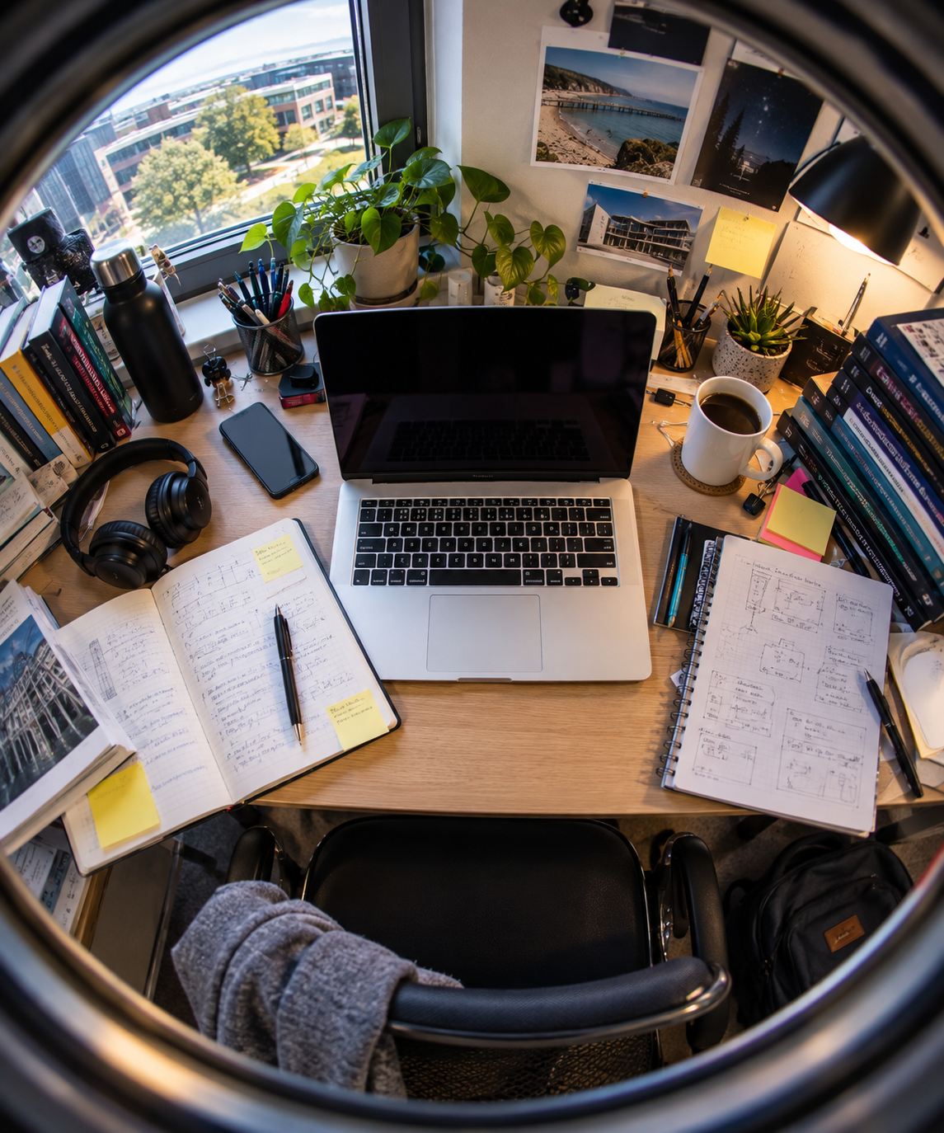
Welcome!
Welcome to our Induction Hackathon!
This hack is open to students across Levels 5, 6 and 7
Participation is optional — but highly encouraged
Work with people you know — or meet someone new
Try something you haven't done before
Most importantly: have some fun building something.

Slide 3

3
You Used a Data Centre to Get Here Today
Streaming music.
Searching Google.
Watching TikTok.
Using Teams.
Playing an online game.
Using ChatGPT.
All that computing happens somewhere.
And increasingly, the infrastructure behind our digital lives is becoming part of a much bigger public debate.

Slide 4
4
AI Isn't Floating in a Cloud
AI, cloud computing, streaming and other digital services require physical infrastructure.
Servers. Buildings. Electricity. Cooling. Networks. Water. People.
As our demand for computing increases, so does the infrastructure required to provide it.
Whether you think that's exciting, worrying, useful, wasteful — or a mixture of all four — it's worth exploring.

Slide 5
5
Everyone Seems to Have an Opinion
ENERGY! WATER! AI! JOBS!
CARBON! INVESTMENT! LOCAL COMMUNITIES!
Data centres are rarely far from the headlines.
The media presents competing narratives around economic benefits, technological development, energy demand, and environmental and community concerns.
But what do people actually think?

Slide 6


6
We Have Data.
Colleagues at Maynooth University surveyed people in Ireland about data centres.
The survey explores:
what people know about data centres
where they get their information
what they believe about their impacts
attitudes towards environmental, social and economic issues
whether they think they know enough to form an opinion
Now we're giving the data to you.

Slide 7

7
THE CHALLENGE
MAKE IT PLAYABLE.
Use the supplied data to create a working software artefact that lets people:
EXPLORE • PLAY • QUESTION
EXPERIMENT • DISCOVER • CONTRIBUTE
Help someone engage with the data-centre debate in an interesting way.

Slide 8
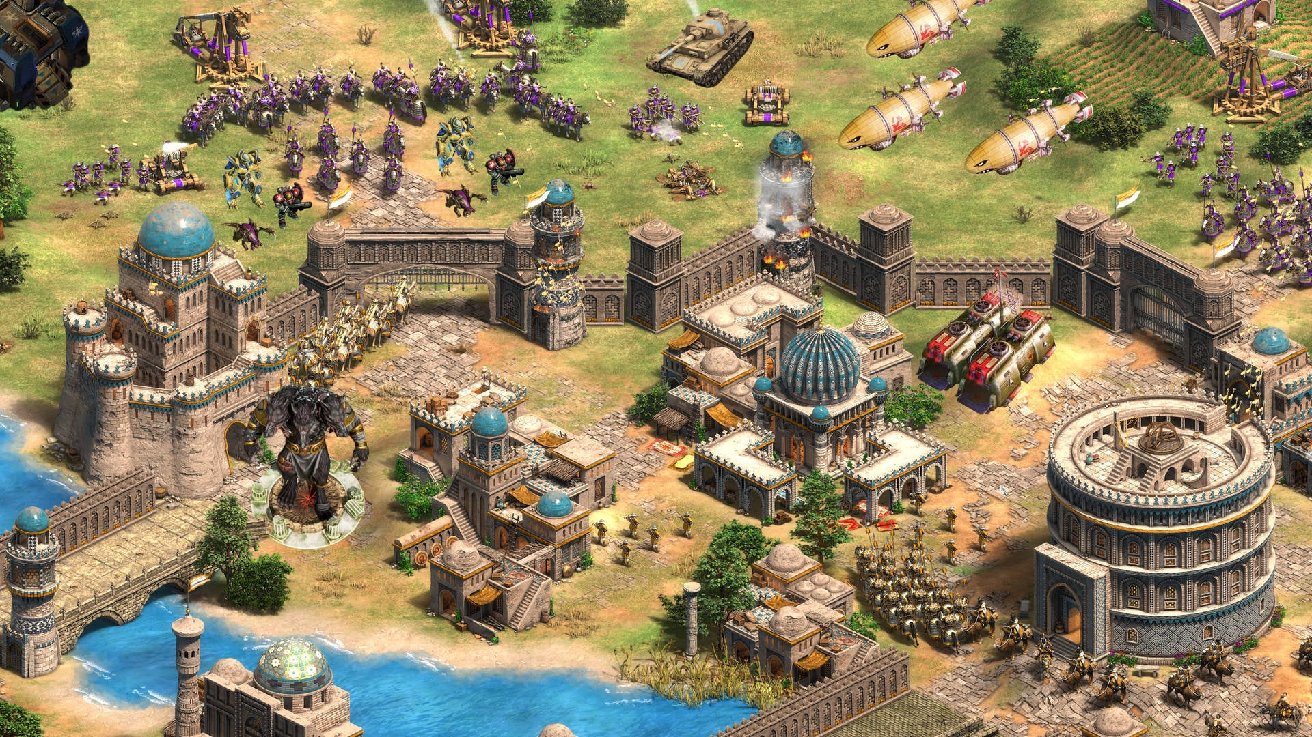
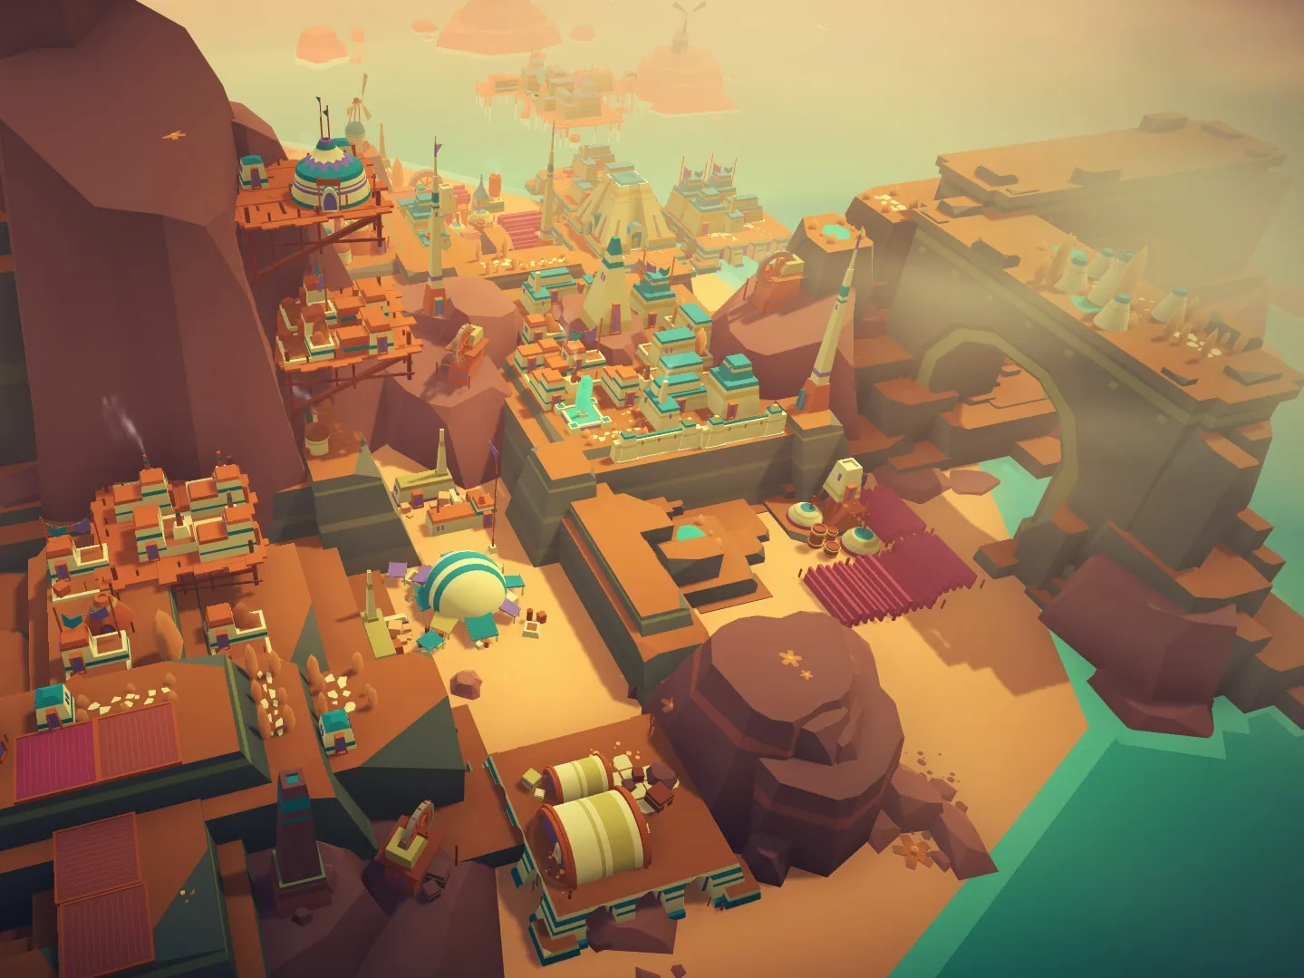
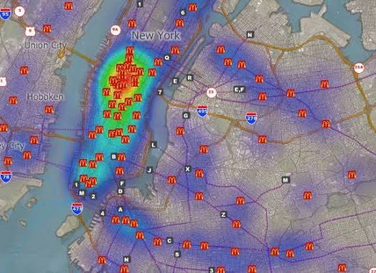
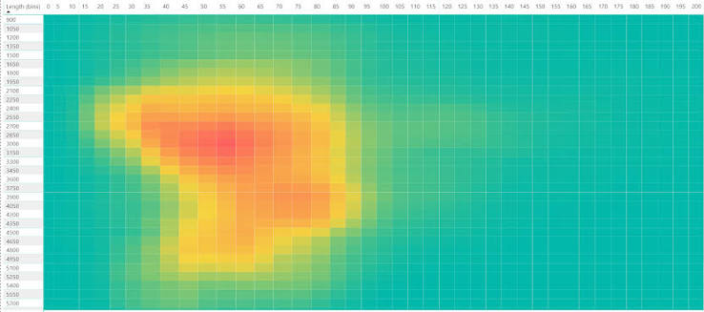
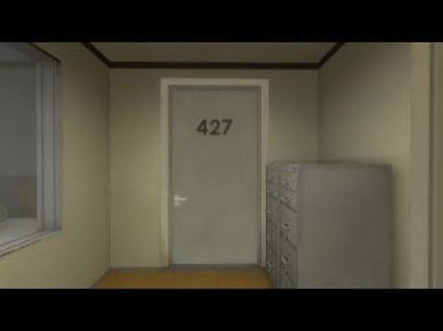
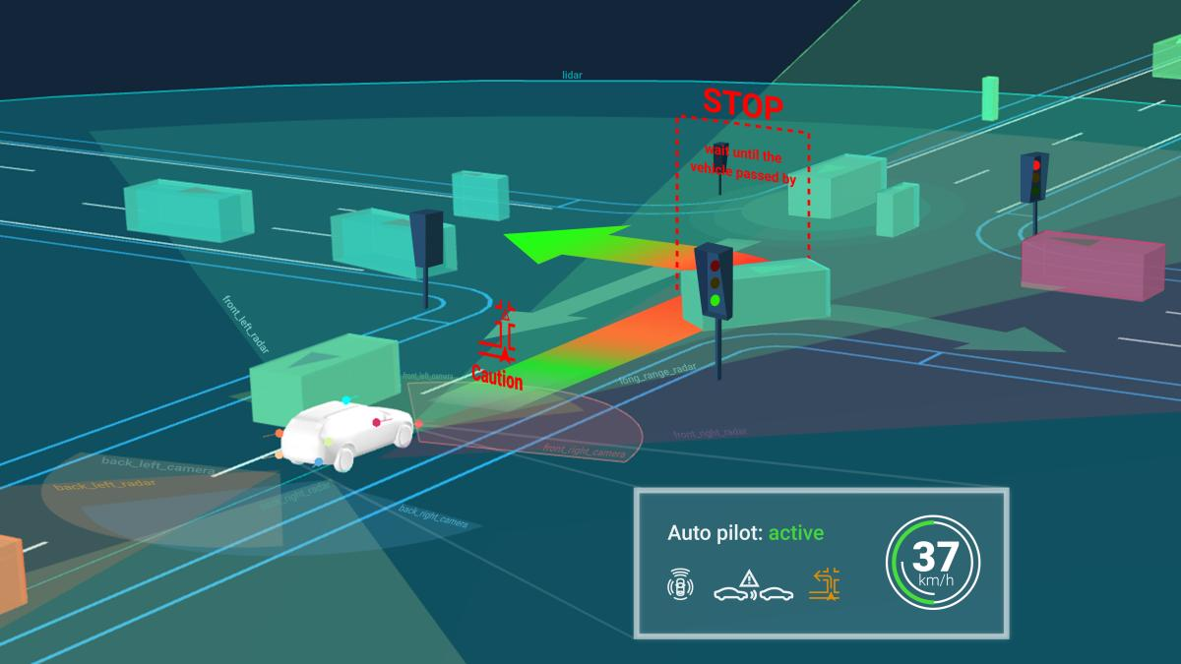
8
What Could You Make?
A game — balance energy, water, cost and public opinion
Headline or Hype? — compare headlines with evidence
An interactive world map — compare different countries
A perception quiz — beliefs versus data
A crowdsourcing application — What do YOU think?
A scenario simulator — What happens as AI demand grows?
An interactive story
Something we haven't thought of!

Slide 9
9
A Possible Game...
Or Ask the Player...
BUILD A DATA CENTRE
You need more computing capacity.
But you also need to balance:
  Electricity
  Water
  Carbon
  Cost
  Jobs
  Communities
  Public acceptance
  AI demand
What choices would YOU make?
Could real data drive the game?
HOW MUCH ELECTRICITY DO YOU THINK DATA CENTRES USE?
5% — 10% — 20% — 30% — 40%?
Make your guess.
→ Reveal the data.
→ See how other people answered.
→ Compare yourself with the Maynooth survey.
→ Ask another question.
Data exploration doesn't have to look like a dashboard.

Slide 10
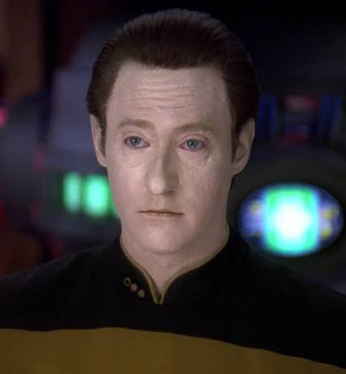
11
The Survey Is Your Starting Point
You can use other data too:
• electricity consumption and demand
• renewable energy
• water and carbon emissions
• economic impacts
• geography and population
• international comparisons
• policy, regulation and media coverage
Mix things together.
What happens when one dataset tells a different story from another?
Different countries and regions have taken different approaches.
Some have restricted development, changed planning requirements, introduced energy requirements, encouraged renewable generation, addressed water consumption, looked at heat reuse, or tried to attract further investment.
Could your artefact let users explore different approaches?

Slide 11
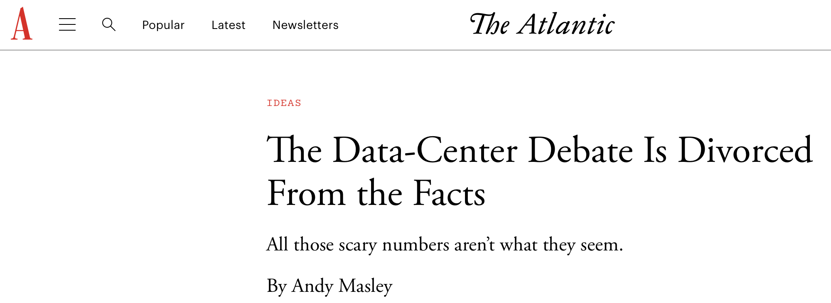
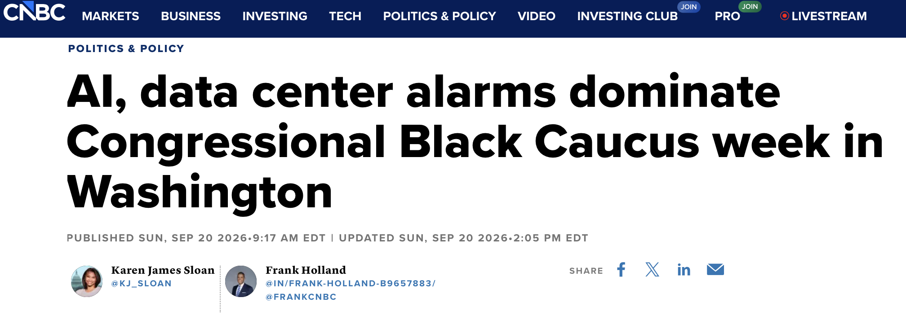
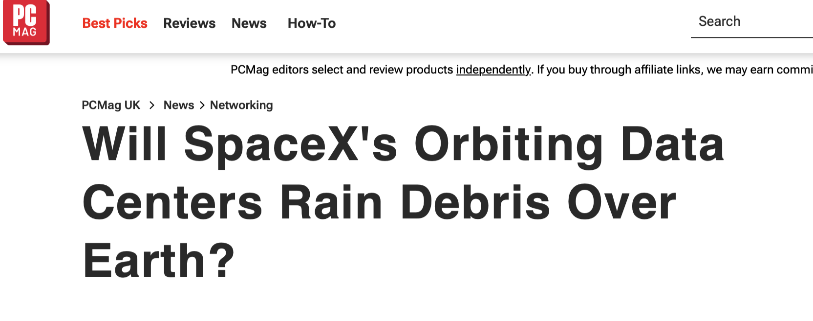
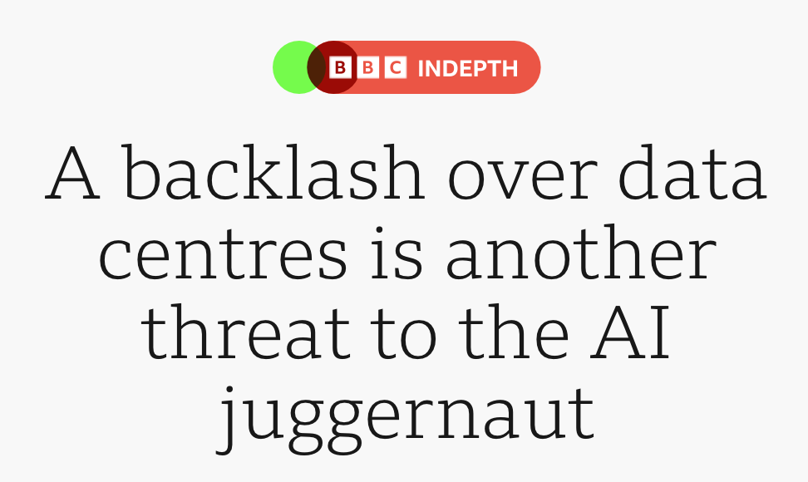
13
Behind the Headlines
You could even make the news itself part of your artefact.
Take a headline. Ask:
What is it claiming?
What evidence does it use?
What does the survey say?
What does other data say?
What is missing?
Challenge Your Assumptions

Slide 12
15
One Important Distinction
DATA ≠ OPINION ≠ ASSUMPTION
Someone believing something is interesting data in itself.
It doesn't necessarily make the belief true.
Likewise, one statistic doesn't necessarily tell the whole story.
Can your software help people explore that difference?

Slide 13
16
Important!
Your hack must:
✓ be a working software artefact
✓ make meaningful use of the supplied survey data
✓ contain a playful or genuinely interactive element
✓ give the user something meaningful to DO
A collection of static charts isn't enough.
A dashboard isn't automatically interactive just because it has filters.
CODE. PLAY. EXPLORE.

Slide 14
18
Tech? Up to You!
Use whatever helps you turn your idea into something real.
• Python + Streamlit / Plotly
• JavaScript / D3.js / p5.js
• React / Next.js
• Three.js
• Unity / Godot
• Maps, AR / VR, mobile, APIs...
Generative AI tools are allowed and encouraged.
Use them to help you learn, experiment and build.

Slide 15
19
Work Together
Teams of up to 5
Mix different skills.
Mix different study levels.
Programmers are useful.
Designers are useful.
Data people are useful.
People with strange ideas are very useful.
You don't all need to know how to do the same thing.
Collaboration > Competition

Slide 16
20
Show Us What You Made
GIVE US A SHORT LIVE 5 MINUTE DEMO
No lengthy presentation.
Show us:
what you made
what the user can do
what data you used
what you discovered
what worked — and what didn't!
We want to see the thing — not slides about the thing.

Slide 17
21
What Are We Looking For?
Not the biggest application. Not the most code. Not the most complicated AI.
IDEA — Is there an interesting concept?
DATA — Is the data used meaningfully?
INTERACTION — Is it interesting to use?
INSIGHT — Does it make us think or discover something?
BUILD — Did you actually make it work?
TEAMWORK — Did you build it together?

Slide 18
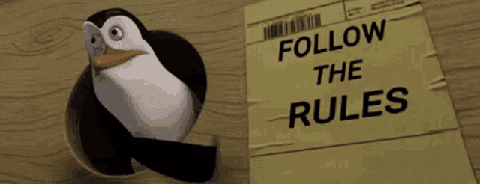
22
The Rules
1. Build working software.
2. Use the supplied survey data.
3. Make it interactive and playful.
4. Teams of no more than 5.
5. AI tools are allowed.
6. Don't misrepresent the data.
And the most important rule...
HAVE FUN.

Slide 19

23
Same Data. Different Ideas.
One dataset.
Lots of possible questions.
Even more possible artefacts.
There isn't a solution we're waiting for you to discover.
WE DON'T KNOW WHAT YOU'RE GOING TO BUILD.
That's the point.
HAPPY HACKING 🚀

Slide 20
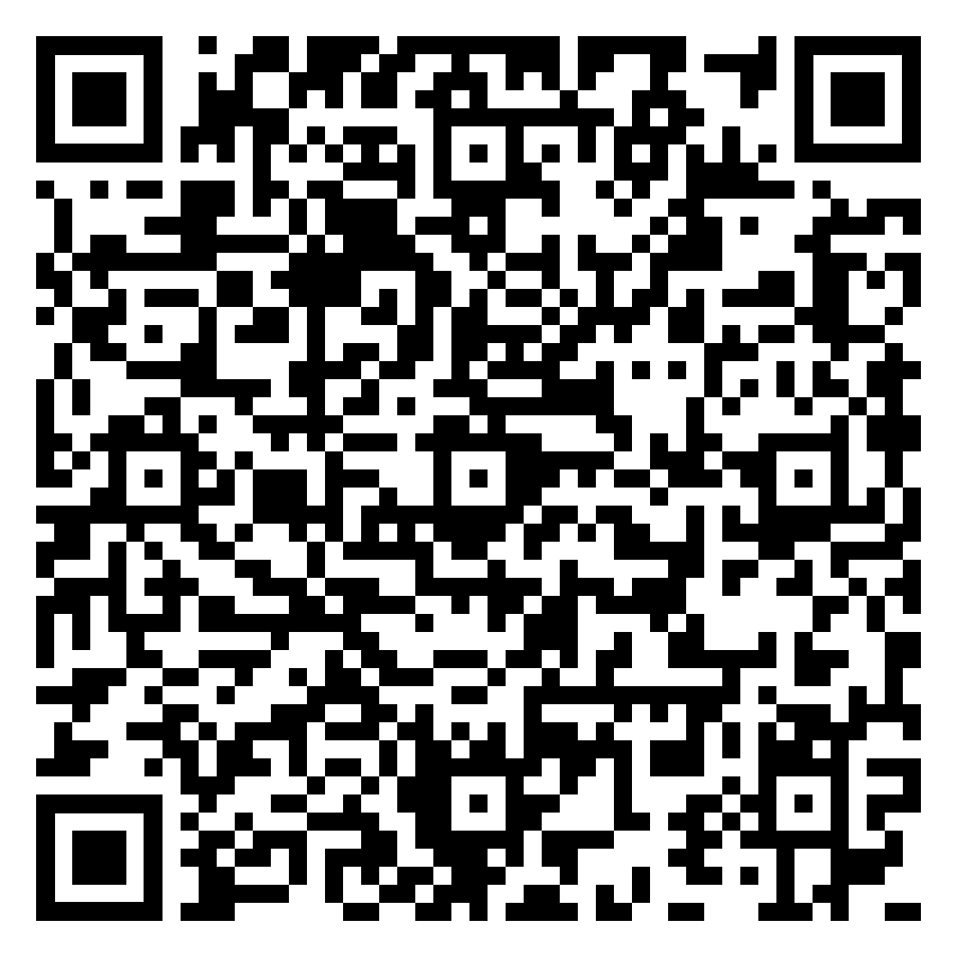
23
The Data
https://livebournemouthac-my.sharepoint.com/:f:/g/personal/gliebchen_bournemouth_ac_uk/IgCU0SZVfVHnT6uWDXAu7z7bAR-hVwKnSnQQEU0NFLcPpBc?e=b3fWqc

